Slide 1
RUNGTA COLLEGE OF DENTAL SCIENCES AND RESEARCH
DEPARTMENT OF GENERAL MEDICINE

Slide 2
SPECIFIC LEARNING OBJECTIVES
MUST KNOW | NICE TO KNOW | DESIRE TO KNOW
ASCITES | PARACENTESIS | SAAG
DIAGNOSIS | CAUSES | COMPLICATION
CLINICAL FEATURES | PATHOGENESIS | DIAGNOSIS
TREATMENT | TESTS
PERITONOTIS

Slide 3
CONTENTS
DIAGNOSIS
PHYSICAL EXAMINATION
CAUSES
EVALUATION
PARACENTESIS
PATHOGENESIS
CLINICAL FEATURES
DIAGNOSIS
PARACENTESIS TECHNIQUES
LABORATORY DATA
CULTURE
APPROPRIATE TESTS
SERUM ASCITES ALBUMIN GRADIENT
CLASSIFICATION OF ASCITES
COMPLICATIONS
PERITONITIS
TREATMENT

Slide 8
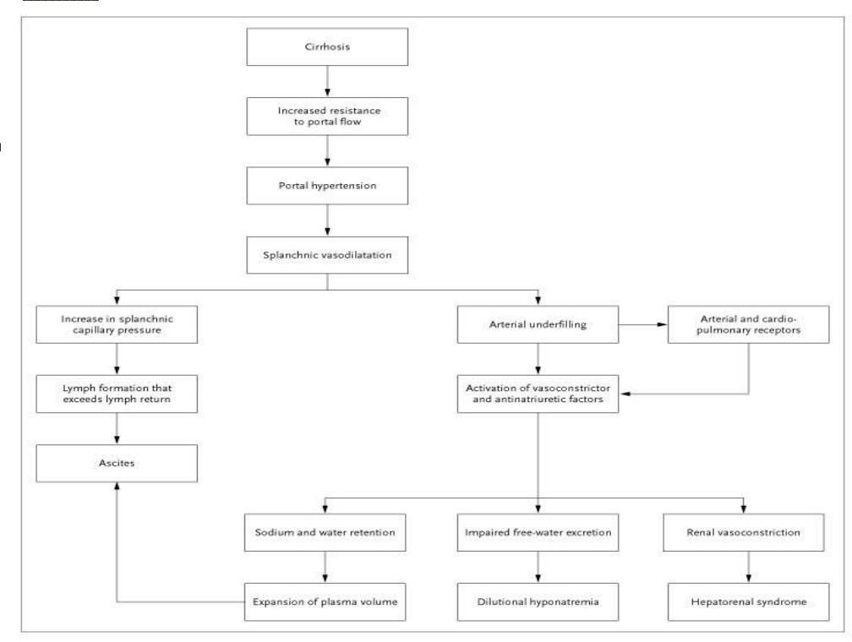

Slide 9
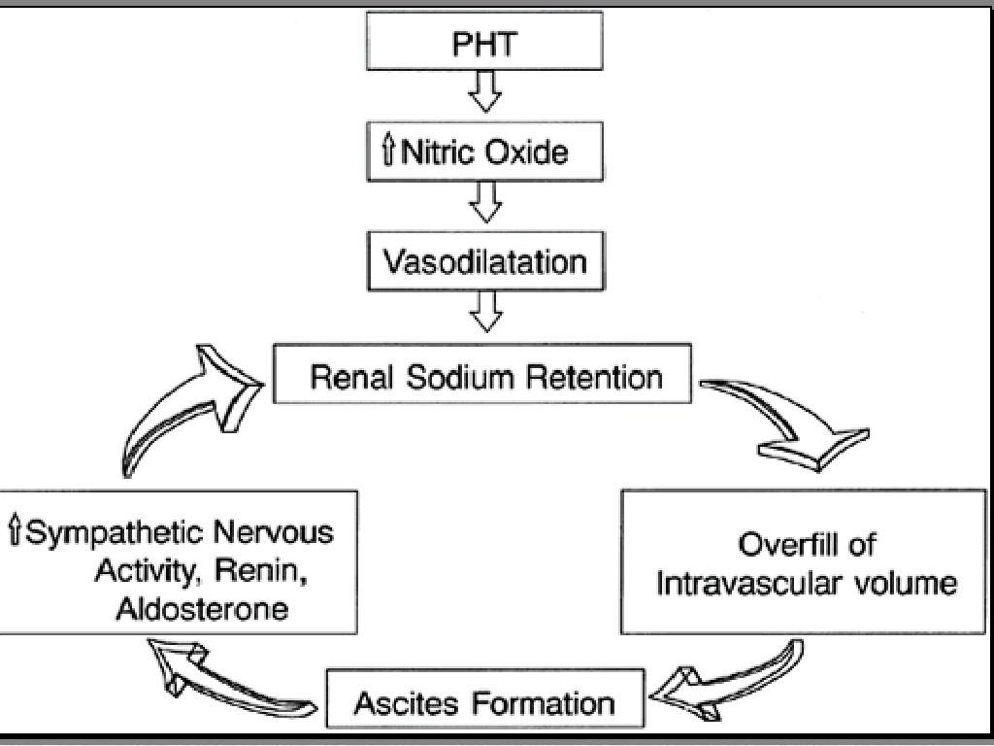

Slide 20
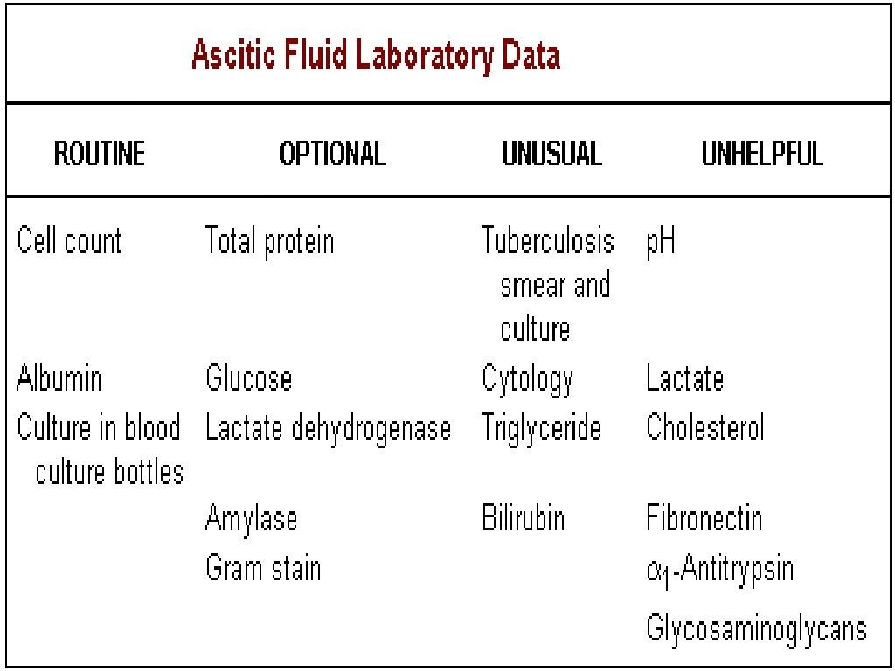

Slide 29
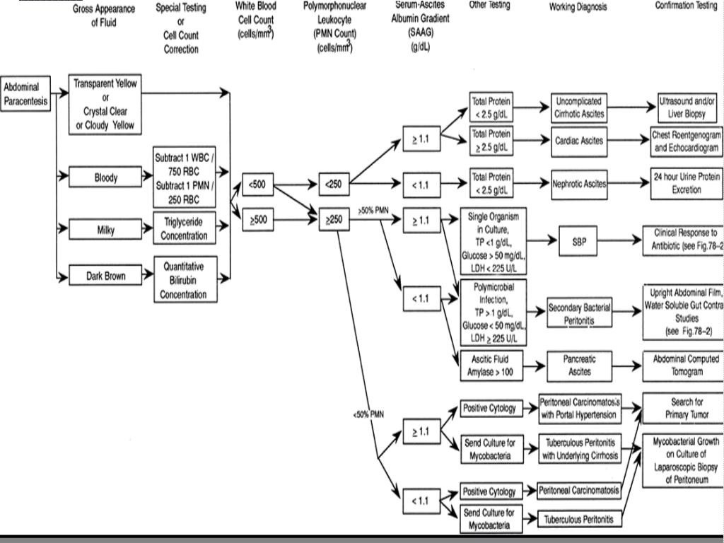

Slide 34
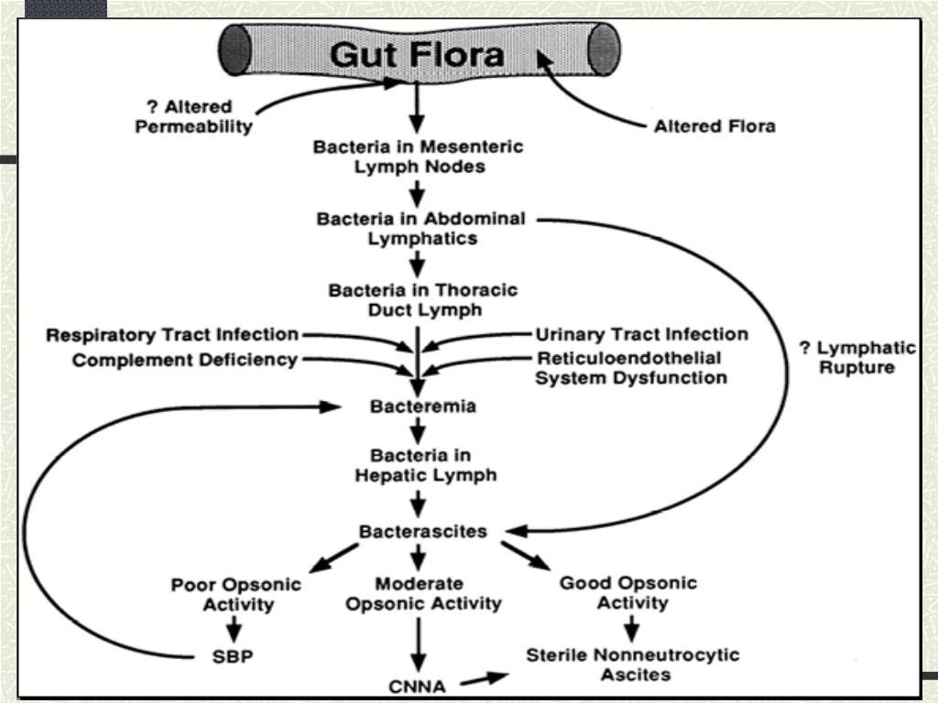

Slide 58
CIRRHOSIS CAUUSES 80-85 % OF ASCITES
ASCITES IS DERIVED FROM THE GREEK WORD “ASKOS” MEANS BAG OR SAC
IT MEANS PATHOLOGIC FLUID COLLECTION WITHIN THE ABDOMINAL CAVITY
THE DEVELOPMENT OF ASCITES IS ASSOCIATED WITH A POOR PROGNOSIS AND IMPAIRED QUALITY OF LIFE IN PATIENTS WITH CIRRHOSIS

Slide 59
REFERENCES
DAVIDSON’S PRINCIPLES AND PRACTICE OF MEDICINE; 23rd edition
HARRISON’S PRINCIPLE OF INTERNAL MEDICINE; 21ST edition
TEXTBOOK OF CLINICAL MEDICINE by S.N Chugh ;5th edition

Slide 60
QUESTION AND ANSWERS

Slide 61
THANK YOU....

